Slide 1

Customer Shopping Behavior Analysis
Analyzing 3,900 customer transactions to uncover spending patterns, preferences, and strategic opportunities across product categories and customer segments.

Slide 2
DATASET OVERVIEW
Understanding Our Data Foundation
3,900
18
50
25
Total Purchases
Data Points
Locations
Products
Transactions analyzed across all categories
Features tracking demographics and behavior
Geographic spread of customer base
Unique items across four categories
Dataset captures customer demographics, purchase details, shopping behavior, and subscription status. Only 37 missing values in Review Rating column, ensuring high data quality for analysis.

Slide 3

DATA PREPARATION
Python Analysis & Data Cleaning
Data Processing Steps
Key Statistics
Loaded dataset using pandas for initial exploration
Average Purchase: $59.76
Age Range: 18-70 years (mean: 44)
Imputed missing Review Ratings using category medians
Review Rating: 3.75/5.0 average
Standardized columns to snake case format
Previous Purchases: 25.4 average per customer
Created age_group bins for segmentation
Connected to PostgreSQL for advanced SQL analysis and business intelligence.
Dropped redundant promo_code_used column

Slide 4


REVENUE INSIGHTS
Gender & Spending Patterns
Male Customers
$157,890 total revenue
68% of total revenue generated
2,652 male customers in dataset
Female Customers
$75,191 total revenue
32% of total revenue generated
1,248 female customers in dataset
Male customers represent the majority of our customer base and drive significantly higher revenue. Marketing strategies should balance retention of this core segment while expanding female customer engagement.

Slide 5

High-Value Discount Users
Identified 839 customers who used discounts but still spent above the $59.76 average purchase amount.
These strategic shoppers demonstrate that discounts don't necessarily mean lower-value transactions. They represent opportunities for:
21.5%
Targeted premium product promotions
Loyalty program enrollment
Bundle offers that increase cart value
Purchase amounts ranged from $62 to $97, showing strong spending power even with discounts applied.
Of discount users are high spenders

Slide 6
TOP PERFORMERS
Product Excellence by Rating
1
2
3
Gloves
Sandals
Boots
3.86 average rating
3.84 average rating
3.82 average rating
4
5
Hat
Skirt
3.80 average rating
3.78 average rating
These top-rated products should be featured prominently in marketing campaigns and product recommendations to drive conversion and customer satisfaction.

Slide 7



Customer Segmentation Analysis
New Customers
1
83 customers (2%)
Returning Customers
2
701 customers (18%)
Loyal Customers
3
3,116 customers (80%)
Subscription Behavior
Subscription Status
958 repeat buyers (>5 purchases) with subscriptions
27% are subscribers (1,053 customers)
2,518 repeat buyers without subscriptions
73% non-subscribers (2,847 customers)
Significant opportunity to convert loyal customers into subscribers.
Average spend similar: $59.49 vs $59.87

Slide 8
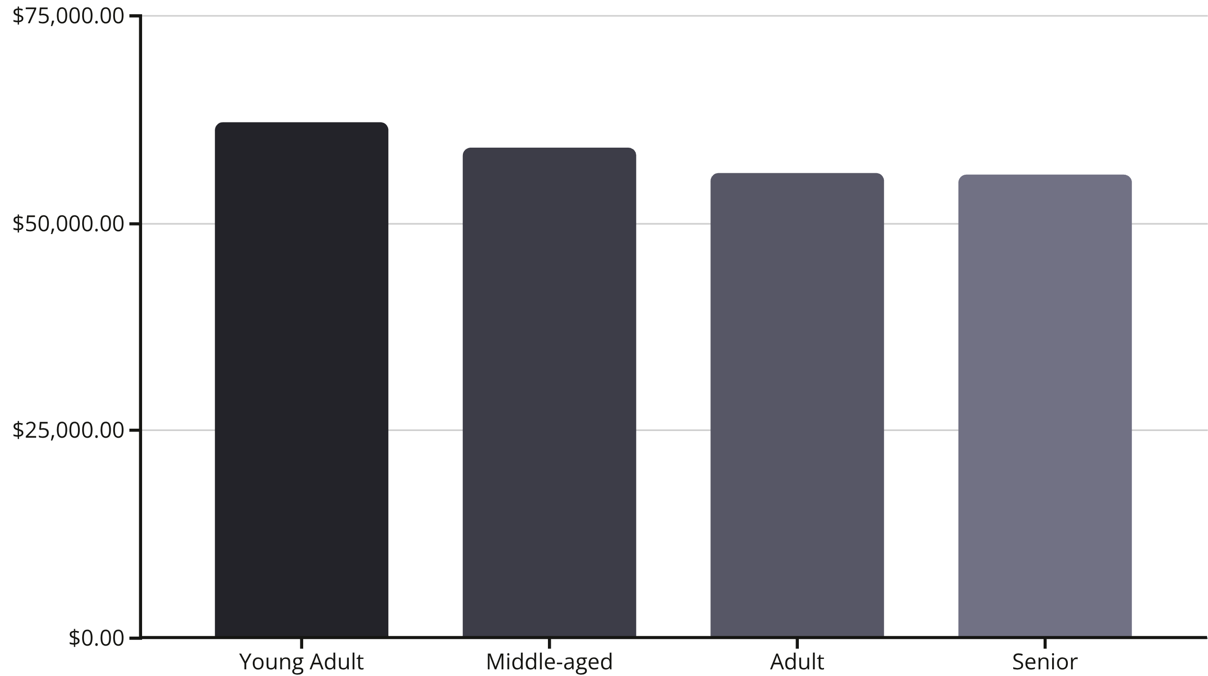
REVENUE BREAKDOWN
Age Group Performance
Young Adults lead revenue generation at $62,143, followed closely by Middle-aged customers. Revenue distribution is relatively balanced across age groups, suggesting broad market appeal. Focus marketing efforts on Young Adult segment while maintaining engagement across all demographics.

Slide 9

POWER BI DASHBOARD
Interactive Business Intelligence
Dynamic Filtering
Filter by subscription status, gender, category, and shipping type for customized insights.
Visual Analytics
Revenue and sales breakdowns by category, age group, and customer segments.
Key Metrics
Track 3.9K customers, $59.76 average purchase, and 3.75 average rating at a glance.

Slide 10





STRATEGIC ACTIONS
Business Recommendations
Boost Subscriptions
Promote exclusive benefits to convert the 73% non-subscriber base. Target loyal customers with >5 purchases.
Customer Loyalty Programs
Reward repeat buyers to accelerate movement from Returning to Loyal segment. Focus on the 701 returning customers.
Review Discount Policy
Balance sales boosts with margin control. 839 high-spending discount users show strategic pricing opportunities.
Product Positioning
Highlight top-rated products (Gloves, Sandals, Boots) and best-sellers in marketing campaigns.
Targeted Marketing
Focus on Young Adult segment ($62K revenue) and express-shipping users who spend $60.48 on average.

